Slide 1
Exotic distances and nearest neighbors
CS771: Introduction to Machine Learning
Nisheeth

Slide 2




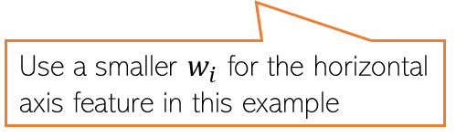
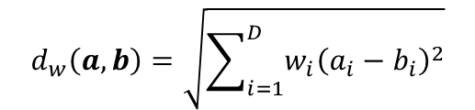



Improving LwP when classes are complex-shaped
Using weighted Euclidean or Mahalanobis distance can sometimes help
Note: Mahalanobis distance also has the effect of rotating the axes which helps
$$μ_{+}$$
$$d_{w}\left(a,b\right)=\sqrt{\sum_{i=1}^{D}{{w_{i}\left(a_{i}−b_{i}\right)}^{2}}}$$
$$μ_{−}$$
Use a smaller $w_{i}$ for the horizontal axis feature in this example
A good W will help bring points from same class closer and move different classes apart
W will be a 2x2 symmetric matrix in this case (chosen by us or learned)
$$μ_{−}$$
$$d_{w}\left(a,b\right)=\sqrt{{\left(a−b\right)}^{⊤}W\left(a−b\right)}$$
$$μ_{+}$$
$$μ_{+}$$
$$μ_{−}$$

Slide 3

What is Mahalanobis Distance?
Recall
And its generalization
Where W is a diagonal matrix
The Mahalanobis distance further generalizes the weighted Euclidean distance
Here, S is the covariance matrix
$$μ_{−}$$
$$μ_{+}$$
$$μ_{+}$$
$$μ_{−}$$

Slide 4
Supervised Learning using Nearest Neighbors

Slide 5
Nearest Neighbors
Another supervised learning technique based on computing distances
Very simple idea. Simply do the following at test time
Compute distance of of the test point from all the training points
Sort the distances to find the “nearest” input(s) in training data
Predict the label using majority or avg label of these inputs
Can use Euclidean or other dist (e.g., Mahalanobis). Choice important just like LwP
Unlike LwP which does prototype based comparison, nearest neighbors method looks at the labels of individual training inputs to make prediction
Applicable to both classification as well as regression (LwP only works for classification)

Slide 6
Nearest Neighbors for Classification
Reference material

Slide 7
Nearest Neighbor (or “One” Nearest Neighbor)
Non-linear decision boundary
Nearest neighbour approach induces a Voronoi tessellation/partition of the input space (all test points falling in a cell will get the label of the training input in that cell)
Test point
Test point

Slide 8




K Nearest Neighbors (KNN)
In many cases, it helps to look at not one but $K$ > 1 nearest neighbors
Essentially, taking more votes helps!
Also leads to smoother decision boundaries (less chances of overfitting on training data)
$K$ = 1
Test input
$K$ = 3
How to pick the “right” K value?
K is a free parameter in the model
Also, K should ideally be an odd number to avoid ties

Slide 9
Setting parameter values
The black magic of machine learning
“Predictions are hard, especially about the future” – Yogi Berra
Basic idea: find parameter values for which you make the fewest possible mistakes on training data
Pray that training data is representative
If it’s not, your model will work badly
We will see some nice math that helps
Soon!

Slide 10
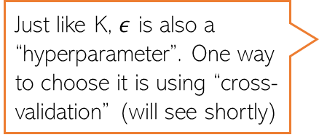

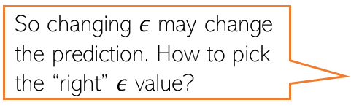
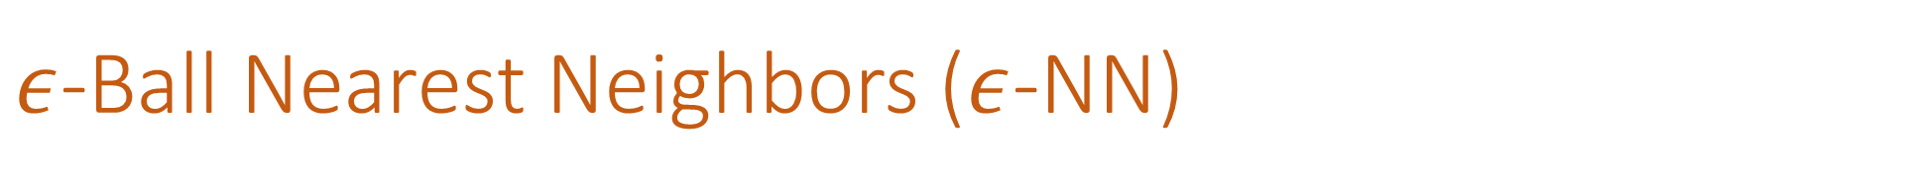
$ε$-Ball Nearest Neighbors ($ε$-NN)
Rather than looking at a fixed number $K$ of neighbors, can look inside a ball of a given radius $ε$, around the test input
So changing $ε$ may change the prediction. How to pick the “right” $ε$ value?
Test input
Just like K, $ε$ is also a “hyperparameter”. One way to choose it is using “cross-validation” (will see shortly)

Slide 11


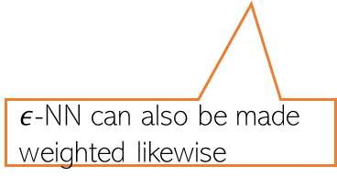





Distance-weighted KNN and $ε$-NN
The standard KNN and 𝜖-NN treat all nearest neighbors equally (all vote equally)
An improvement: When voting, give more importance to closer training inputs
$K$ = 3
Test input
$$\frac{1}{3}$$
+
$$\frac{1}{3}$$
+
$$\frac{1}{3}$$
=
In weighted approach, a single red training input is being given 3 times more importance than the other two green inputs since it is sort of “three times” closer to the test input than the other two green inputs
Unweighted KNN prediction:
$$\frac{3}{5}$$
+
$$\frac{1}{5}$$
+
$$\frac{1}{5}$$
=
Weighted KNN prediction:
$ε$-NN can also be made weighted likewise

Slide 12
KNN/$ε$-NN for Other Supervised Learning Problems
Can apply KNN/𝜖-NN for other supervised learning problems as well, such as
Multi-class classification
Regression
Tagging/multi-label learning
For multi-class, simply used the same majority rule like in binary classfication case
Just a simple difference that now we have more than 2 classes
For regression, simply compute the average of the outputs of nearest neighbors
For multi-label learning, each output is a binary vector (presence/absence of tag)
Just compute the average of the binary vectors
Result won’t be a binary vector but we can report the best tags based on magnitudes
We can also try the weighted versions for such problems, just like we did in the case of binary classification

Slide 13
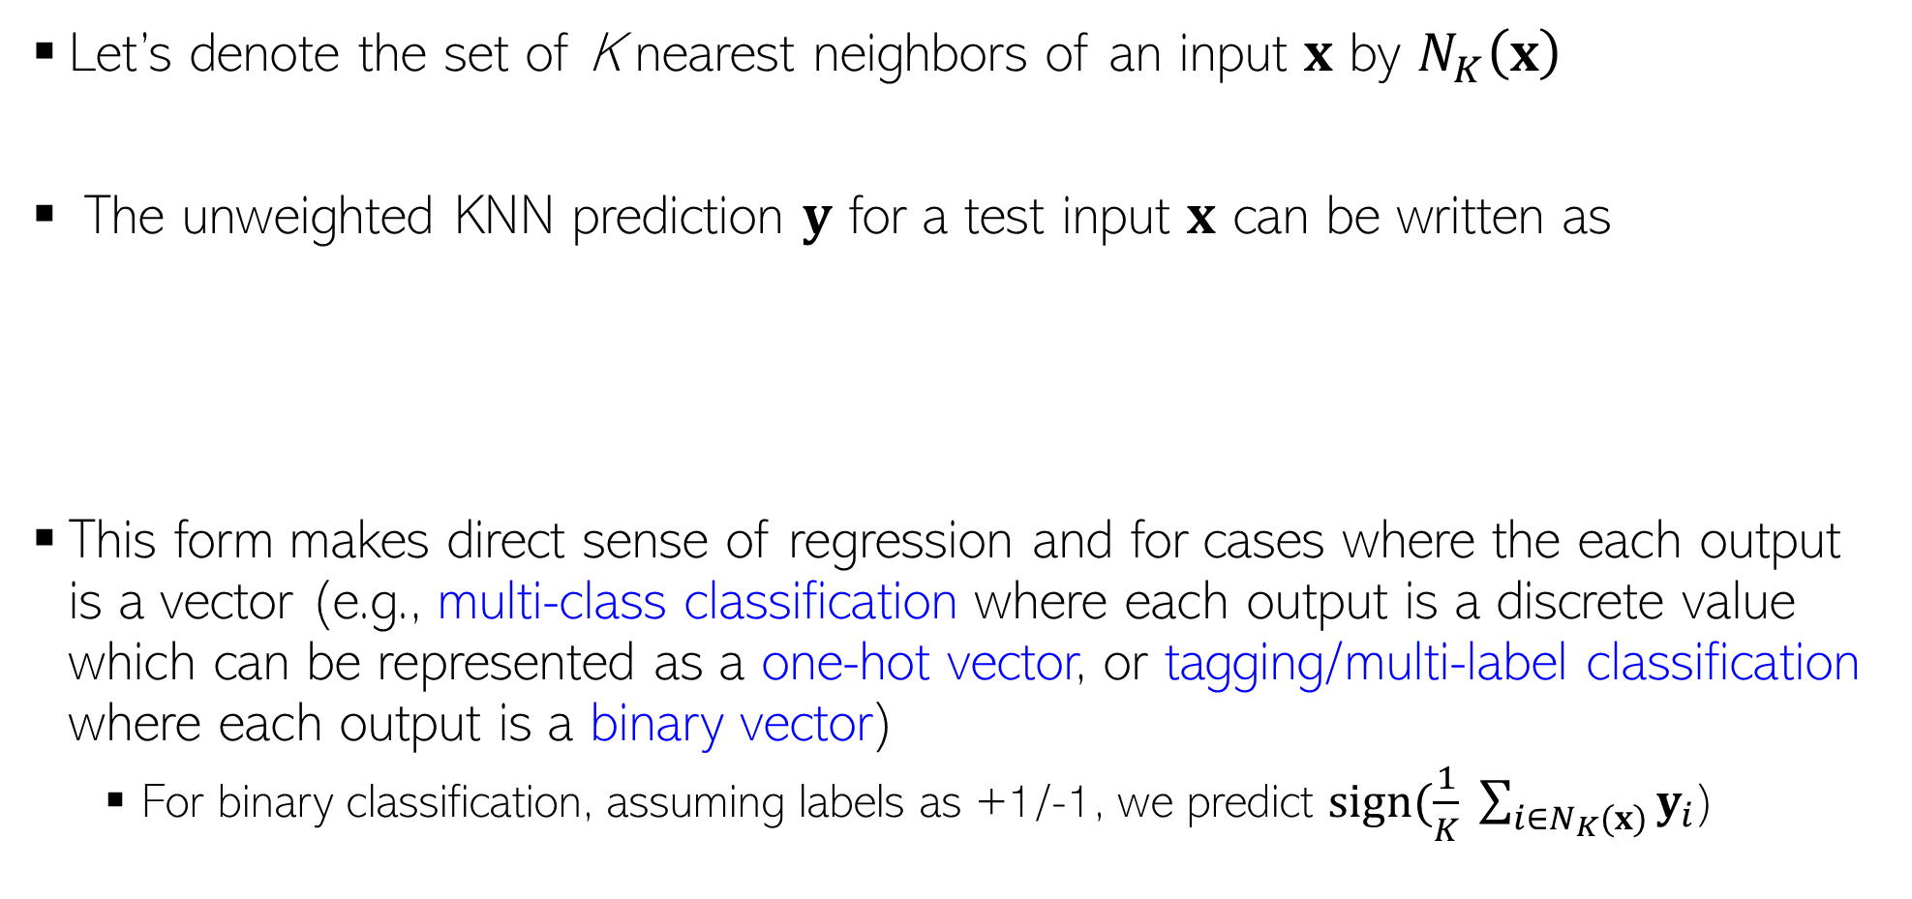

KNN Prediction Rule: The Mathematical Form
Let’s denote the set of K nearest neighbors of an input $x$ by $N_{K}\left(x\right)$
The unweighted KNN prediction $y$ for a test input $x$ can be written as
This form makes direct sense of regression and for cases where the each output is a vector (e.g., multi-class classification where each output is a discrete value which can be represented as a one-hot vector, or tagging/multi-label classification where each output is a binary vector)
For binary classification, assuming labels as +1/-1, we predict $sign(\frac{1}{K} \sum_{i∈N_{K}(x)}{y_{i}}$)
For discrete labels with 5 possible values, the one-hot representation will be an all zeros vector of size 5, except a single 1 denoting the value of the discrete label, e.g., if label = 3 then one-hot vector = [0,0,1,0,0]
$$y= \frac{1}{K} \sum_{i∈N_{K}(x)}{y_{i}}$$

Slide 14
Nearest Neighbours: Some Comments
An old, classic but still very widely used algorithm
Competitive with state-of-the-art approaches most of the time
Can work very well in practice with the right distance function
How do we pick the right distance function?
Requires lots of storage (need to keep all the training data at test time)
Prediction step can be slow at test time
For each test point, need to compute its distance from all the training points
Clever data-structures or data-summarization techniques can provide speed-ups

Slide 15
Data types determine distance choice
/
Ratio
Interval
Ordinal
Nominal

Slide 16
Ratio
Ratio data can be reasonably compared as multiples or fractions of each other
Measure quantities
Zero has a meaning
Examples:
Someone's weight
A bottle's capacity

Slide 17
Interval
Can be measured on a scale
Differences between values are meaningful
Multiples and fractions of measurements are not meaningful
Examples:
Customer satisfaction ratings
Temperature, in Fahrenheit

Slide 18
Ordinal
Can be expressed in terms of rank or position
Only relative ranks are meaningful
Cannot do arithmetic with it
Examples:
Positions in a race
Protein sequence in genome

Slide 19
Nominal
Items in a nominal scale belong to a category
No other information about them
Can be numeric, but this does not make them ordinal
Examples:
Phone numbers
People in CS771

Slide 20
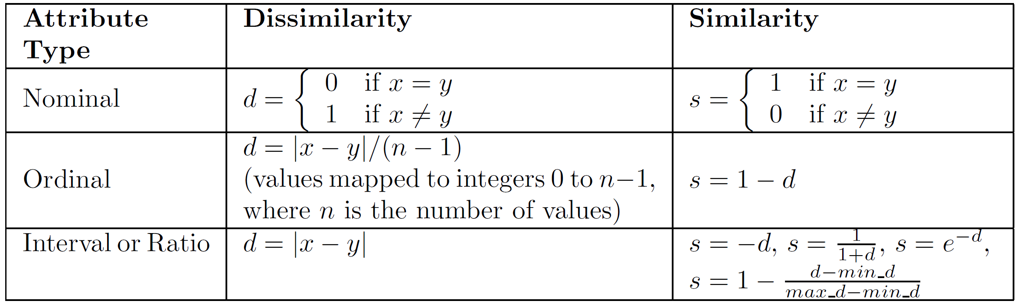
From data to distance
Nominal and ordinal values are usually converted to one-hot vector representations
Have to be careful this representation does not cloud their meaning

Slide 21
For ratio and interval-scaled features
Euclidean distance is your basic workhorse
Use it if you can think of nothing else
Squared Euclidean distance will also work fine if your features are range normalized
Useful when you want to save the compute of taking square roots
Manhattan distance is also useful when time presses
Only simple additions and subtractions involved
More exotic metrics may be needed in specific situations
Read this for some examples

Slide 22
Similarity for binary-valued vectors
Independent of feature type
Compute the following quantities
F01 = number of attributes where x is 0 and y is 1
F10 = number of attributes where x is 1 and y is 0
F00 = number of attributes where x is 0 and y is 0
F11 = number of attributes where x is 1 and y is 1

Slide 23
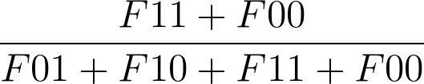
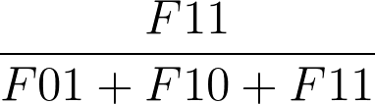
For binary vectors
Simple matching coefficient
Jaccard Coefficient

Slide 24
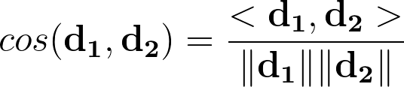
For general vector representations
We use a cosine similarity measure
Where <> indicates a dot product and || || measures the distance of each vector to the origin
Bigger numbers mean the two items are closer
Invert it to obtain a distance measure
Additively, multiplicatively or exponentially

Slide 25
Next Lecture
Hyperparameter/model selection via cross-validation
Learning with Decision Trees

